Slide 1
E-INSURANCE PAYMENT MODULE

Slide 2
AIM:- To Analyse The E-Insurance Payment Module

Slide 3
Requriments:- 1.login module 2.User name 3.password 4.website

Slide 4
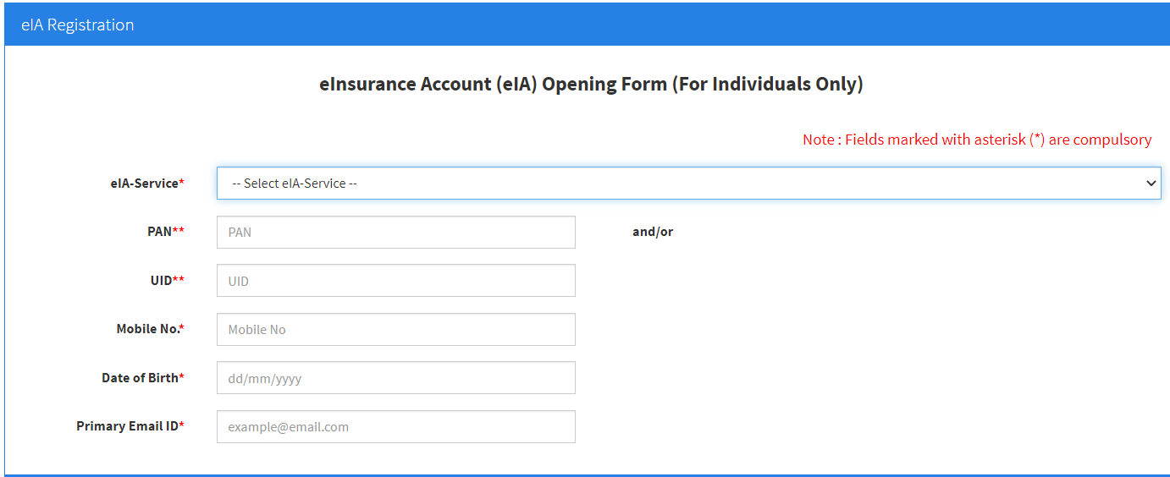
E-Insurance login page:-

Slide 5
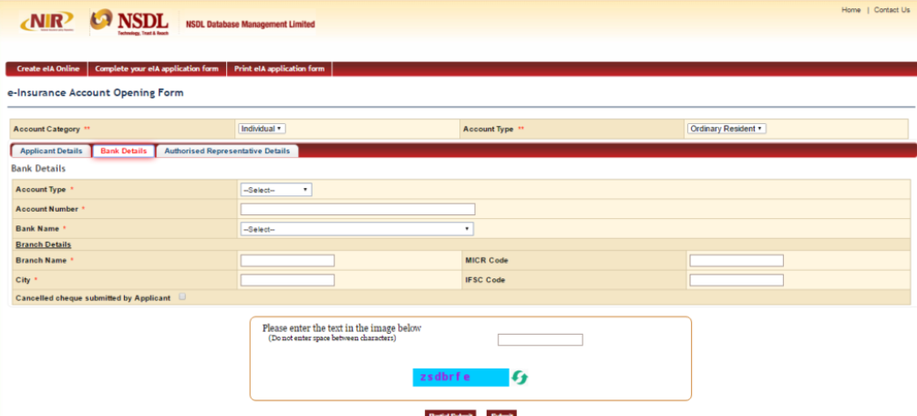
Searching page;-

Slide 6
Positive test scenario;- 1)User Data transmitted to the gateway must be set over a secured(HTTPS or other) channel. 2) Some application ask User to store Card information. In that case, system should store Card information encrypted format. 3) Check for all mandatory fields validation. System should not go ahead with payment process if any data for any field is missing. 4) Test with Valid Card Number + Valid Expiry Date + Invalid CVV Number. 5) Test with Valid Card Number + Invalid Expiry Date + Valid CVV Number.
.

Slide 7
Negative test scenario:- 1.Verify that company logo or name of payment gateway 2.Verify that payment options are displayed or not. for extra credit card, debit card, net banking and UPI options 3.Verify that each option is selectable or not. 4.verify that each payment option opens the respective payment window as per specification or not. 5.Verify that dropdown button is working properly or not.

Slide 8
Test cases:-
Test cases | Type – negative/positive
Ascertain that a claim can be made for both the maximum and minimum payment. | Positive
Ensure that data is correctly delivered to all subsystems, including accounts and reporting. | Negative
Double-check that surrender values are computed in accordance with the policy's requirements. | Negative
Verify the forget password functionality. | Positive
Verify the messages for invalid login. | Positive
Experiment with complex policy lapse and resurrection situations. | Negative
Policy Termination Test Scenarios | Positive
Valuation test calculation of net liability | Positive
Verify the policy for a non-forfeiture option | Negative
Check the premium value according to the product plan. | Negative

Slide 9
Conclusion:- Timely process of the insurance policy and managing client’s data is a foremost priority for any insurance company. Considering all the key aspects of insurance company’s requirement some of the testing strategy and scenarios are represented in this tutorial.

Slide 10


